Slide 1

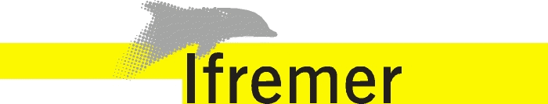
Data Acquisition Software Prototype
WP 13 D 13.4
Guillaume CLODIC
Meeting - Date

Slide 2
Needs
Support new standards (SWE, SensorML, etc.)
Better use of metadatas
Web client to access both real time and historical datas
Near real time data exchange from ship to shore
Facilitate data integration in data centers on shore
14/06/2013

Slide 3
Langage of choice : Java
Pros
  Better support for scalability and portability
  Already used by lot of our systems
  Good support for xml handling
  Lots of very good frameworks
Cons
  Not so good for accurate dating of incoming datas
14/06/2013

Slide 4
Acquisition and broadcasting
Each sensor has its own driver
Creation of a generic driver for simple NMEA sensor (with a description file like SID)
Broadcast both in raw format and autodescriptive format in a common format
Autodiscovery of sensors on the network
14/06/2013

Slide 5
Acquisition and broadcasting
GPS
Generic NMEA Driver
Universal Broadcast
Weather
Generic NMEA Driver
Sounder
Custom Driver
14/06/2013

Slide 6
Clients of universal broadcast
Archiving
Both raw format, NetCDF
Database
Others
Visualisation & Monitoring
Ship to shore communication
10/07/2014

Slide 7
Database Use
Visualisation of historical data
SOS connector
WFS and WMS connectors
Mirroring from ship to shore
10/07/2014

